Slide 1
Your Wealth - Our Mission

Slide 2
PUNJIBAAZAR –
Where Your Wealth Compounds
Our Core Ideology
“Empowering every indian to build generational wealth through ethical, educated and systematic investing”.
Fusion of Indian values with global investment acumen.
Transparent, SEBI-compliant products and ISO- aligned systems.

Slide 3
About Punjibaazar
40+ years of business leadership and ethical wealth stewardship.
Serving HNIs, NRIs, Family Offices, Institutions in India & USA.
Strategies backed by data, structured with discipline, and built for longevity.

Slide 4
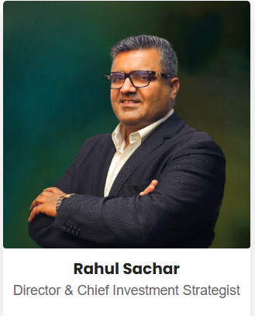
OUR DIRECTORS
Rahul Sachar
Rahul Sachar is driven by a powerful belief: India is entering its golden era of opportunity. While nations like the U.S. and China have already seen their industrial peaks, he views India’s Tier 2 and Tier 3 cities as fertile ground for value creation and long-term wealth compounding.
His Market Knowledge, Research and Analysis has given him highly profitable exits in various investments even upto 11x
Yet, beyond personal gains, a deeper mission emerged to democratize access to such high-potential investments. That vision led to the founding of Punjibaazar, a platform designed to bridge the gap between untapped real-world opportunities and value-conscious investors.

Slide 5
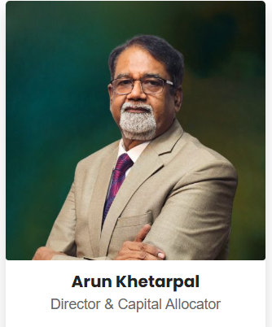
OUR DIRECTORS
Arun Khetarpal
With a robust foundation in science, engineering, and an MBA, Arun Khetarpal brings over four decades of global professional experience to the leadership team at Punjibaazar. His journey spans building businesses across India, the United States, Europe, Japan, and emerging markets, bringing with him a rare mix of technical foresight, analytical rigor, and business acumen.
Arun’s career includes scaling a capital equipment power generation startup to an impressive turnover of ₹700 crores, demonstrating his deep expertise in execution, engineering, and financial strategy. At Punjibaazar, he plays a pivotal role in guiding SMEs, high-net-worth individuals, and foreign investors through complex financial decisions with clarity and confidence.
His multidisciplinary approach, rooted in research, operational excellence, and global perspective—ensures that every investment strategy is future-ready, structurally sound, and financially rewarding. From portfolio management and risk mitigation to alternative investment strategies, Arun has mastered the nuances of wealth creation in diverse financial landscapes.
Arun’s leadership at Punjibaazar is defined by his commitment to trust, transparency, and high performance. He leads with a vision to create long-term value for clients and partners, aligning engineering prowess with investor vision to build ventures that last.

Slide 6
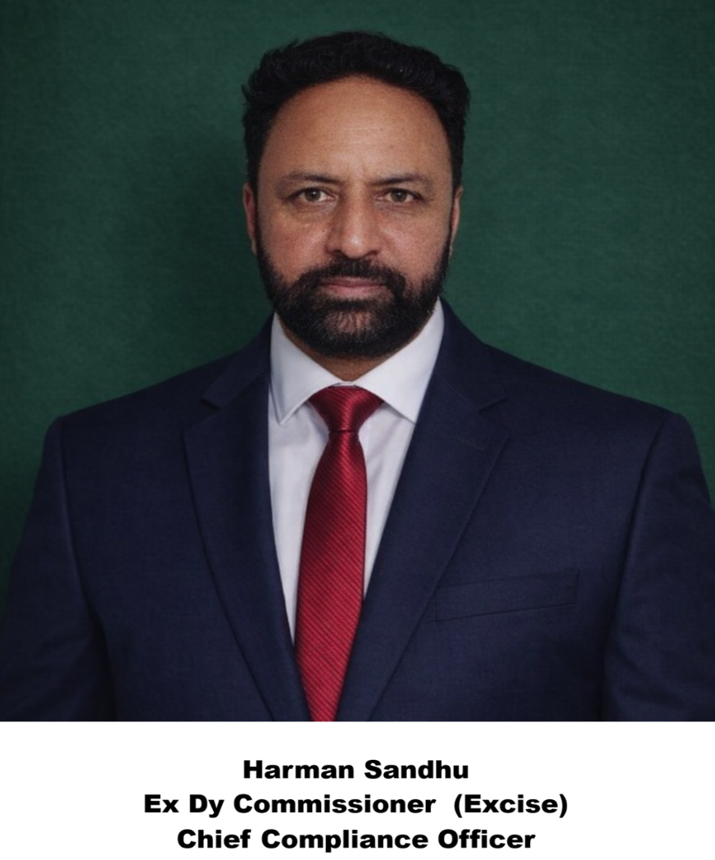
CHIEF COMPLIANCE OFFCER
HARMAN SANDHU
Harman Sandhu, a former Deputy Commissioner in the Excise Department, now serves as the Chief Compliance Officer at a leading wealth management firm—a role that demands both precision and foresight. Drawing on his deep regulatory experience, he oversees the firm’s adherence to SEBI, RBI, and international financial laws, ensuring every investment strategy and client interaction meets the highest standards of integrity.
He scans regulatory updates and ends with strategic reviews of internal audits, always with an eye on risk mitigation and ethical conduct. He’s the architect behind the firm’s compliance manual, the sentinel of its fiduciary responsibilities, and the educator who instills a culture of transparency across teams.
Whether it’s supervising AML protocols, refining cybersecurity measures, or ensuring fair client disclosures, Harman’s leadership is both meticulous and mission-driven. His transition from public service to private wealth has brought a rare blend of discipline and dynamism to the firm’s compliance framework—making him not just a gatekeeper, but a strategic guardian of trust.

Slide 7
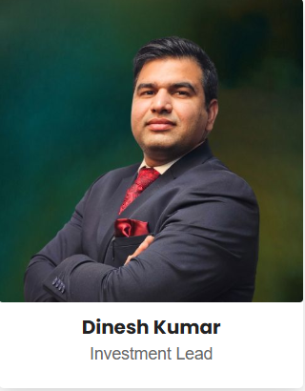
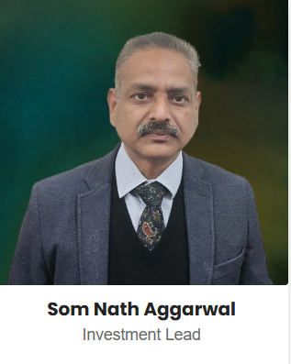
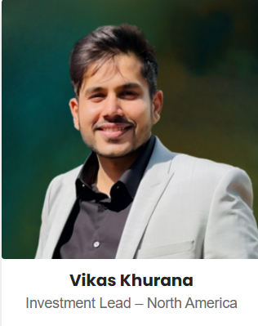
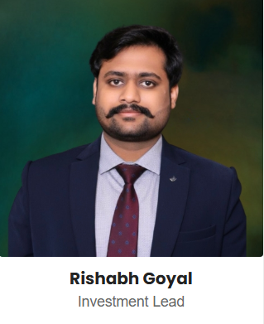
OUR TEAM
CA
MBA- FINANCE AND HR
EX LIC SENIOR MANAGER
MBA HR

Slide 8
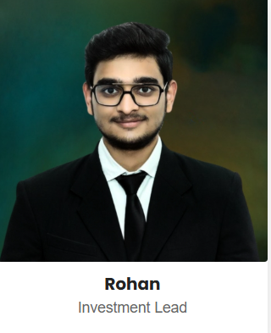
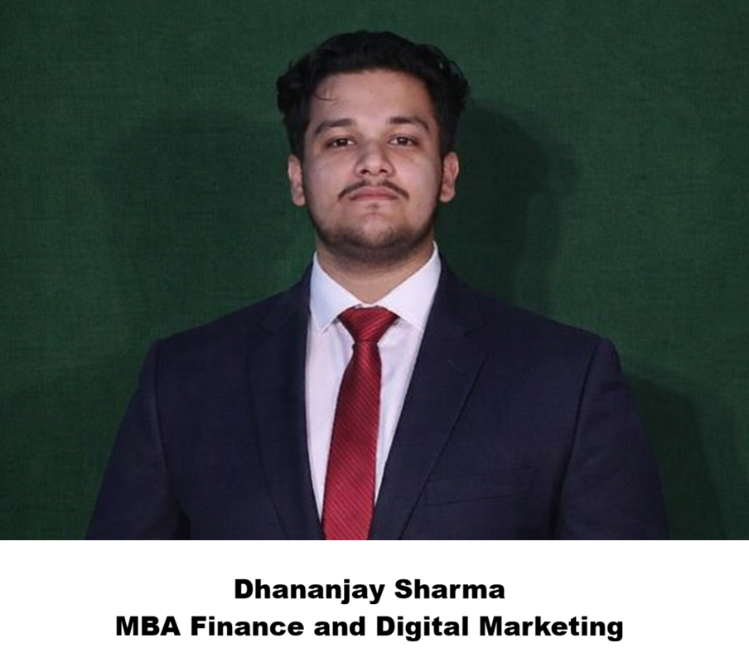
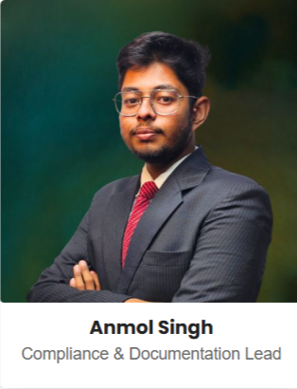
OUR TEAM
MBA Finance

Slide 9
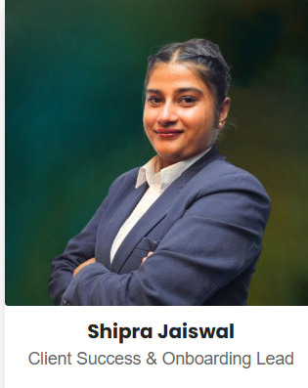
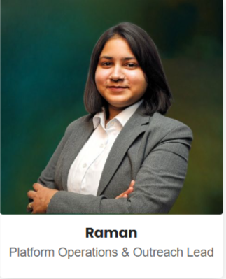
Our Team

Slide 10
Punjibaazar Retirement Income Plan
Earn Regular Income Grow Your Wealth beat Inflation
Retirement Reality
Life Expectancy is increasing (20-30) years post retirement.
Medical and living cost are increasing every year.
Inflation silently reduces purchasing power.
Traditional income sources are no longer sufficient.

Slide 11
The fixed deposit myth
Fixed deposit are safe - but they are enough.
Return 6% to 7% annually.
No wealth creation.
Interest is fully taxable.
Money loses value due to inflation.

Slide 12
Safety without growth is a hidden task
The real risk.
If your money does not grow - it will not last.
Inflation (6-7%) equal to FD returns and then taxes.
Zero/negative real gain.

Slide 13
The smart Alternative Mutual Fund + SWP Strategy
Invest Lumpsum in mutual fund.
Generate monthly income using SWP (systematic withdrawal plan).
Mutual Fund Reality
Hybrid/SWP friendly 8 to 10% funds.
Equity long term is 10-12%.

Slide 14
Assumptions for the proposal
TYPE - Expected returns (Subject to the markets risk)
Conservative - 8%
Moderate - 10% - 12%
Aggressive - 12% - 14%
SWP withdrawal is 6% to 7%

Slide 15
Rs 25 Lacs for 5 years
25 lacs for 05 years @ 8%
Years | Return
01 | 27 lacs
03 | 31.49 lacs
05 | 36.73 lacs
Monthly withdrawal= Rs. 12,500/-
WITH SWP
Total withdrawal = Rs. 7.5 Lacs
Remaining corpus= Rs. 27-28 lacs (~8% CAGR) You earned= Rs 7.5 lacs
Your Capital is still intact/slightly grown.
WITHOUT SWP
Total corpus= Rs. 36 to 37 lacs.
Safe but limited wealth creation.

Slide 16
25 Lacs for 10 years
25 lacs for 10 years @ 12%
Years | Return
01 | 28 lacs
03 | 35.12 lacs
05 | 44.05 lacs
08 | 61.99 lacs
10 | 77.64 lacs
WITH SWP
Monthly withdrawal= Rs 12,500/-Total in 10 years= Rs 15 lacs
Remaining corpus= Rs. 42-43 lacs (~12% CAGR)
WITHOUT SWP
Total corpus = Rs. 75-77 lacs (~12% CAGR)
Here Compounding Begins

Slide 17
25 lacs for 15 years
25 lacs for 15 years @ 12%
Years | Return
01 | 28 lacs
03 | 35.12 lacs
05 | 44.05 lacs
08 | 61.99 lacs
10 | 77.64 lacs
13 | 1.09 lacs
15 | 1.36 lacs
WITH SWP
Monthly income= 12,500/-
Total withdrawal= Rs. 22.50 lacs
Remaining corpus= Rs. 60-62 lacs(~12% CAGR)
WITHOUT SWP
Total corpus= Rs. 1.3 - 1.4 CR (~12% CAGR)
Wealth Multiplies Significantly

Slide 18
50 Lacs for 5 years
50 lacs for 05 years @ 8%
Years | Return
01 | 54 lacs
03 | 62.98 lacs
05 | 73.46 lacs
WITH SWP
Total withdrawal = 25000*60= Rs. 15 lac Remaining Corpus= Rs. 52-54 lacs (~8% CAGR)
You Earned 15 Lacs Capital still intact.
WITHOUT SWP
Total corpus = Rs. 72-74 Lacs
Preservation.

Slide 19
Rs 50 Lacs for 10 years
50 lacs for 10 years @ 12%
Years | Return
01 | 56 lacs
03 | 70.24 lacs
05 | 88.11 lacs
08 | 1.22 Cr
10 | 1.55 Cr
WITH SWP
Expected Returns= (~12% CAGR) Withdrawal= 6% (Rs 3 lac/year) Rs. 25,000/- P.M
Result
Monthly income = Rs 25,000/-Withdrawal in 10 years = Rs 30 lacs Remaining corpus = Rs. 89-92 lacs
WITHOUT SWP
Total corpus = Rs. 1.5-1.6 CR in 10 years (~12% CAGR)
Growth.

Slide 20
Rs 50 lacs for 15 years
50 lacs for 15 years @ 12%
Years | Return
01 | 56 lacs
03 | 70.24 lacs
05 | 88.11 lacs
08 | 1.22 Cr
10 | 1.55 Cr
13 | 2.18 Cr
15 | 2.77 Cr
WITH SWP
Total withdrawal Rs 25000*180= Rs 45 lacs Withdrawal= Rs. 45 lacs
Remaining corpus= Rs 1.6 CR (~12% CAGR)
WITHOUT SWP
Total corpus = Rs 2.7 - 2.74 CR (~12% CAGR)
Wealth Creation

Slide 21
1 Crore for 5 years
1 Cr for 05 years @ 8%
Years | Return
01 | 1.8 Cr
03 | 1.25 Cr
05 | 1.46 Cr
WITH SWP
Total Withdrawal= Rs. 50,000*60= Rs 30 lacs Remaining corpus= Rs. 1.0 - 1.1 CR ( ~8% CAGR)
WITHOUT SWP
Total corpus = Rs 1.4 - 1.5 CR (~8% CAGR)

Slide 22
1 Crore for 10 years
1 Cr for 10 years @ 12%
Years | Return
01 | 1.8 Cr
03 | 1.25 Cr
05 | 1.46 Cr
08 | 2.47 Cr
10 | 3.10 Cr
WITH SWP
Withdrawal= Rs. 6 lacs/year Total= Rs 60 lacs
Expected remaining corpus= Rs.1.7 - 1.8 CR (~12% CAGR)
Half money withdrawn and remaining multiplied. WITHOUT SWP
Total corpus = Rs. 3.0 - 3.1 CR (~12% CAGR) in 10 years.

Slide 23
1 Crore for 15 years
1 Cr for 15 years @ 12%
Years | Return
01 | 1.8 Cr
03 | 1.25 Cr
05 | 1.46 Cr
08 | 2.47 Cr
10 | 3.10 Cr
13 | 4.36 Cr
15 | 5.44 Cr
WITH SWP
Withdrawal= Rs. 6 lacs/year Total withdrawal=Rs. 90 lacs
Remaining corpus= Rs. 2.3 - 2.4 CR (~12% CAGR)
Without SWP
Total corpus= Rs. 5.4 - 5.5 CR (~12% CAGR)

Slide 24
Investment at Glance
Sr No. | Investment (Lacs) | Period (years) | SWP (Lacs) | Return (CAGR) | @ | Return Without SWP | FD @ 7.5% Lacs
1 | 25 lacs | 5 | 7.5 | @8% | 27 - 28 | 36 - 37 | 35.9
 |  | 10 | 15.0 | @12% | 42 - 43 | 75 - 77 | 51.5
 |  | 15 | 22.5 | @12% | 60 - 62 | 130 - 140 | 73.8
2 | 50 lacs | 5 | 15.0 | @8% | 52 - 54 | 72 - 74 | 71.8
 |  | 10 | 30.0 | @12% | 89 - 92 | 150 - 160 | 103.00
 |  | 15 | 45.0 | @12% | 160 - 165 | 270 - 280 | 148.00
3 | 100 lacs | 5 | 30 | @8% | 100 - 110 | 145 - 150 | 144.00
 |  | 10 | 60 | @12% | 170 - 180 | 300 - 310 | 206.00
 |  | 15 | 90 | @12% | 230 - 240 | 540 - 547 | 295.00

Slide 25
PUNJIBAAZAR
We partner with top AMC’s to offer curated investment options. Client money is managed by AMC’s, while we
Advise
Allocate
Monitor Portfolios
Total Assets under management by us on behalf of clients Includes investment across:
AIF (Alternative Investment Funds)
PMS (Portfolio Management Services)
MF (Mutual Funds)
Total AUM managed across AIF, PMS, MF : Rs. 435 CR Growing Steadily with client’s confidence.

Slide 26
Disclaimer - Punjibaazar
Punjibaazar is a registered distributor/advisor of financial products
All investments in Mutual Funds, Alternative Investment Funds(AIFs), Portfolio Management Services (PMS), and other financial instruments are subject to market risks.
Get In Touch
Email - sales@punjibaazar.com or support@punjibaazar.com
Mob NO +91 9056951844
Address – G1-179, Tijara, Biwandi, Alwar, Rajasthan – 301019
Serving clients across India, U.S., and other international markets.

