Slide 1
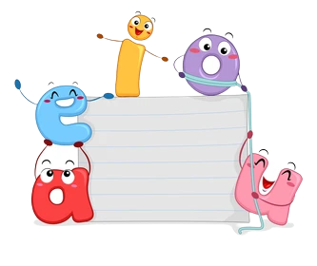
FUN WITH

Slide 2
Learning Outcome
SWBAT understand the difference between consonants and vowels.
SWBAT identify consonants and vowels.
Materials required: Lesson No.: U1_GL1
Lesson Plan No.: U1_GLP1
Worksheet No.: U1_GWS1

Slide 3
Breathing Exercise
Sit in a comfortable position. Close your eyes. At the count of 1, breathe in. At the count of 2, breathe out (repeat this 5 times).

Slide 4
Picnic is Fun
Hi Alok! Let me tell you a story!
Ok Vidya! I love to listen to stories!
Notes:
Could you ask sapna for a pic of vidya and change thi
s accordingly

Slide 5
There were 26 letters. Together they were called the Alphabet.
The letters go on a picnic to the lake. They find a big banyan tree for shade and sit under it.

Slide 6
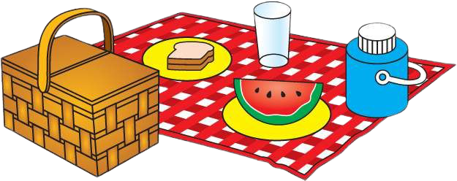
Letters Ww, Dd, Uu and Zz are eating and drinking together. Letter Yy is dancing! Letter Ss and letter Aa are sleeping.
ZzZzZzZzZz

Slide 7
Letter Oo is playing on the swing. Letters Mm, Ii, Kk, Bb and
Ee are waiting in a line, to play on the swing.

Slide 8
Letters Aa, Ee, Ii, Oo and Uu climb the tree when no one is
looking! Letter Dd looks up at them and asks,
We are VOWELS. Only vowels can climb trees.
How did you climb the big banyan tree?

Slide 9
VOWELS are the only letters that are said with an open mouth!
Can you say AaAa, EeEe, OoOo and UuUu?
You are a CONSONANT, letter Dd. You and the other letters in the alphabet, are called CONSONANTS. You are 21 in total.
If Aa, Ee, Ii, Oo and Uu are vowels, what am I?

Slide 10
Show me your fist, Alok! Let’s learn the vowels again. Aa-- Ee--Ii-- Oo-- Uu

Slide 11
Very good, Alok! Let’s say the consonants!

Slide 12
Ex. 1: Choose the right answer to the question.
The alphabet can be divided into two groups. What are the names of the groups?
Vowels and others
Vowels and y
Consonants and vowels
2. How many consonants are there in the English alphabet?
21
26
5

Slide 13
Ex. 1: Choose the right answer to the question.
3. Find the odd one out: u, x, t, d, f
d
f
u
4. The consonants in the word “auto” are:
t
o
u

Slide 14
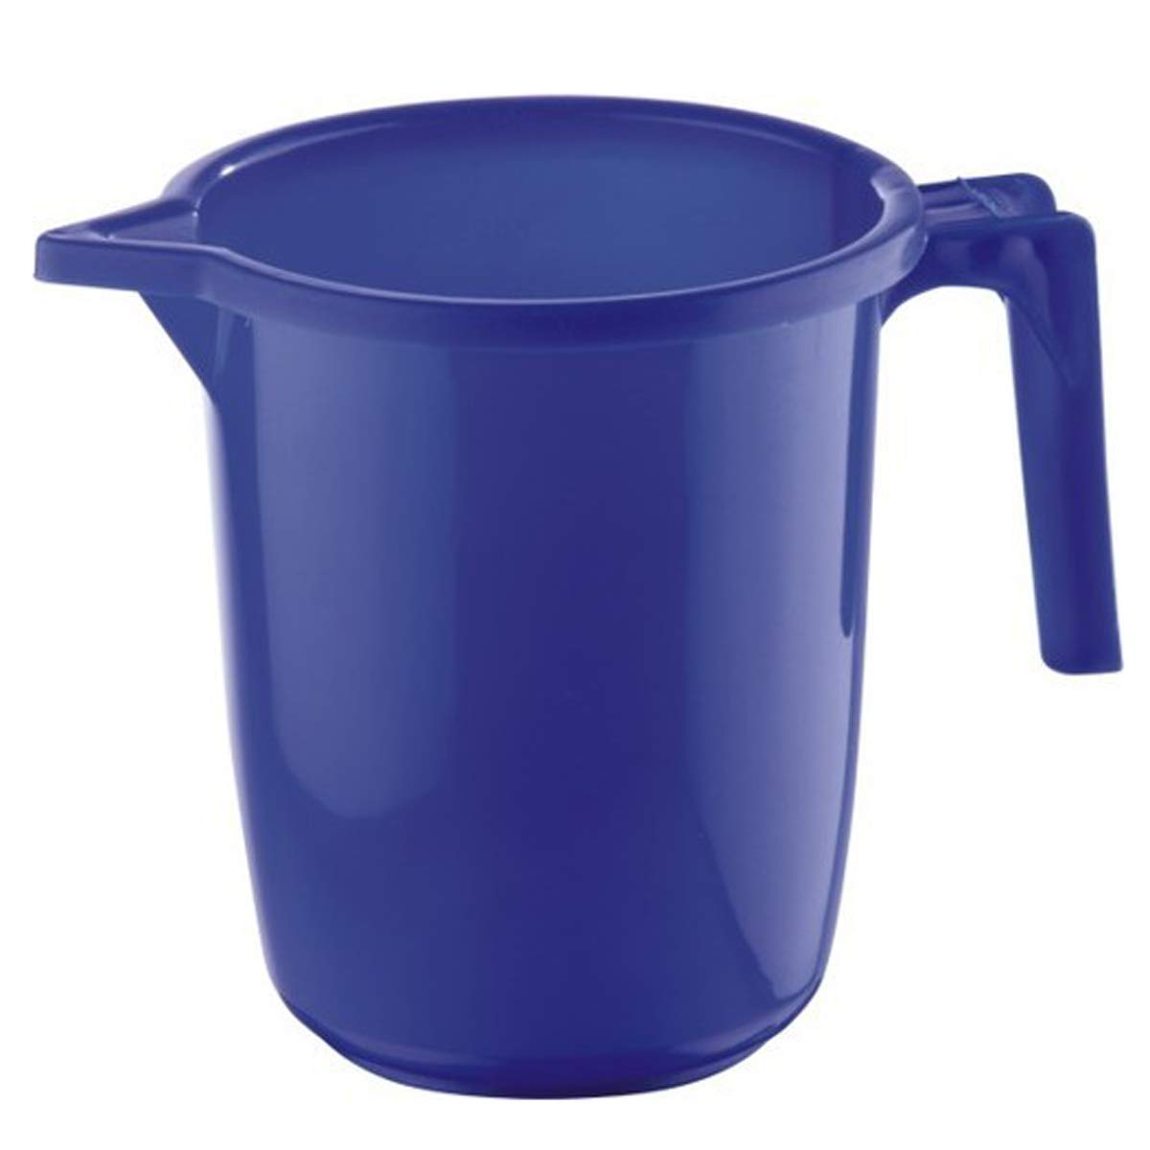
Ex. 2: Match the vowels to the words. Follow the example.
book
mug
eyes
rat
twig
Aa
Ee
Ii
Oo
Uu

Slide 15
Ex. 3: Match the consonants to the beginning letter of the word. Follow the example.
zoom
roar
cry
you
me
Yy
Mm
Zz
Rr
Cc

Slide 16
Vowels
Consonants

Slide 17
Thank You!

