Slide 1
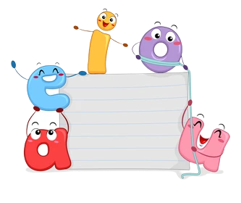
FUN WITH

Slide 2
Learning Outcome
SWBAT understand the difference between ‘here’ and ‘there’.
SWBAT use ‘here’ and ‘there’ appropriately.
Materials required: Lesson Plan No.: U1_GLP4
Worksheet No.: U1_GWS4

Slide 3
Breathing Exercise
Sit in a comfortable position. Close your eyes. At the count of 1, breathe in. At the count of 2, breathe out (repeat this 5 times).

Slide 4
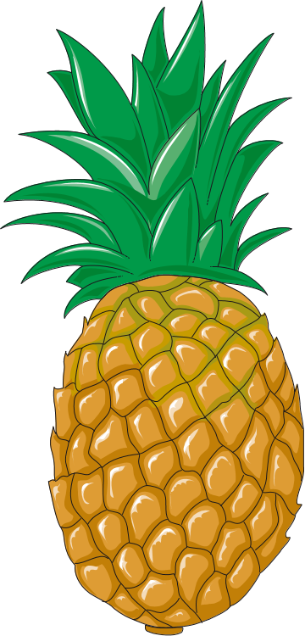
This
That

Slide 5
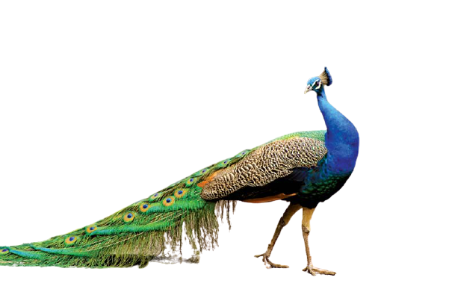
This
That
Used when an object is nearby.
Used when an object is far away.
This
That

Slide 6
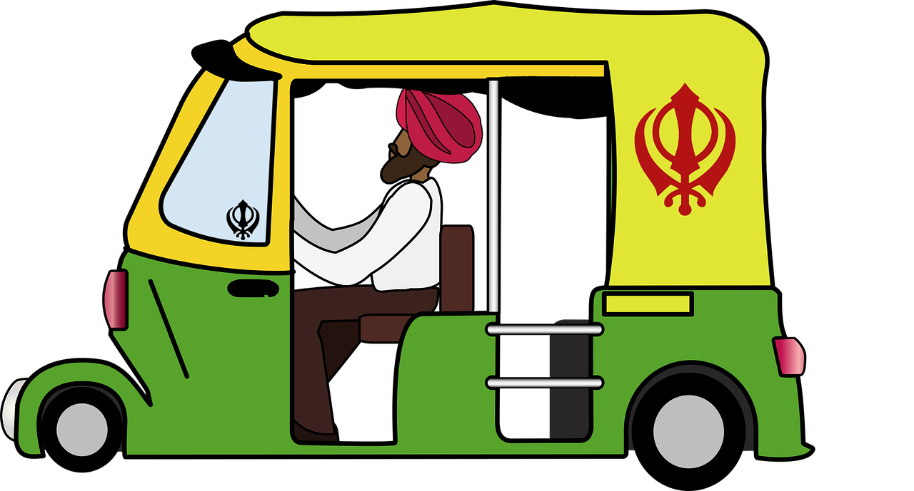
That auto
This
When looking at something or someone.
When pointing out to something or someone.
This auto
That

Slide 7
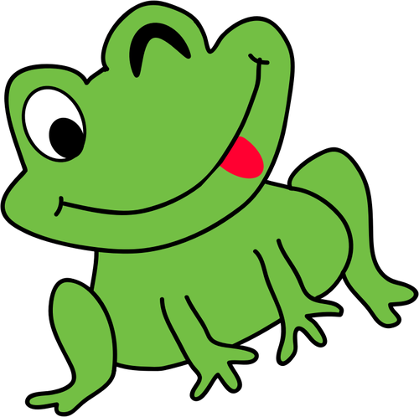
This
Look at this book!
Look at that book!
boat
That

Slide 8
This
I will wait for this bus.
I will wait for that bus.
That

Slide 9
This
This is Rajiv’s house.
That is Rajiv’s house!
That

Slide 10
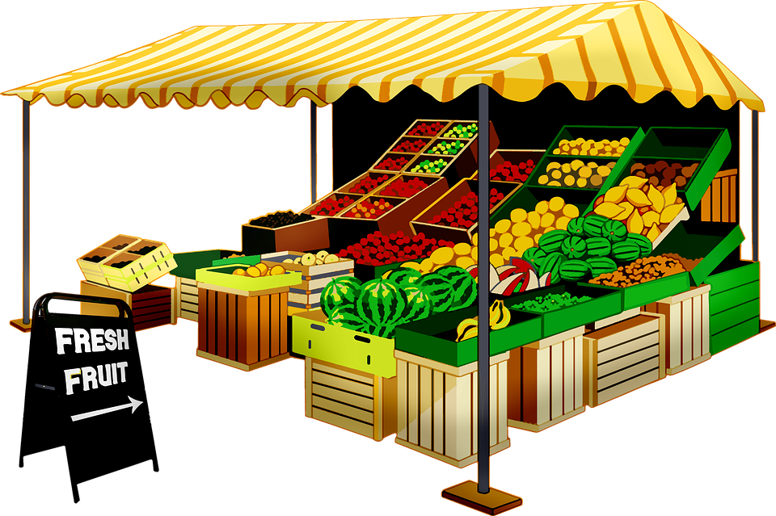
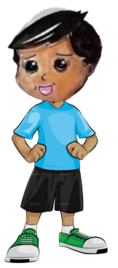
This is Alok!
Alok and Vidya go to the fruit shop.
That is Vidya!

Slide 11
I want that papaya.
I want this watermelon.
Let’s see what fruits they buy!

Slide 12
Sure, Alok! I want that bunch of grapes.
Vidya, I want to buy and eat this banana.

Slide 13
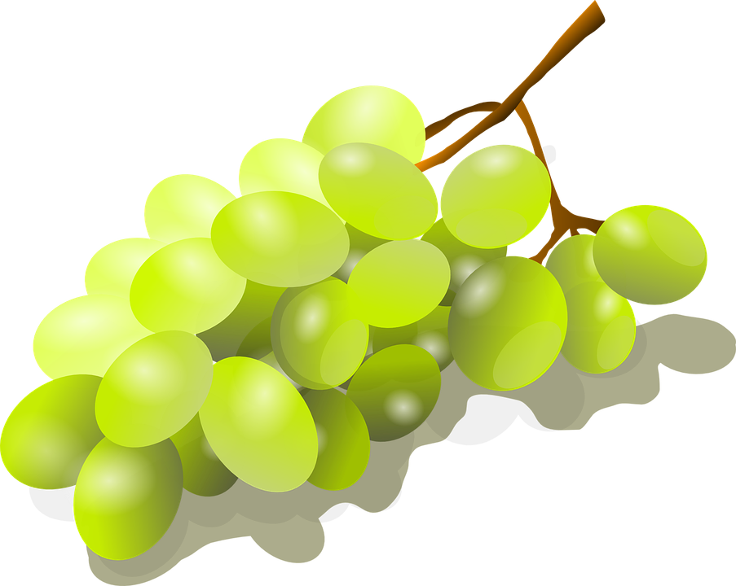
Alok eats the banana, while Vidya packs up her purchase in a cloth bag.
They decide to walk back home together.

Slide 14
Look at this tree! It’s so green.
That tree looks green too, Alok.

Slide 15
Vidya tells Alok she wants to pet the goats before they go inside the house.
This flower is beautiful, Vidya. Do you want to smell it?

Slide 16
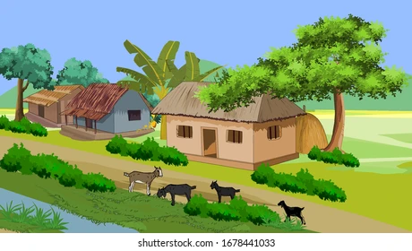
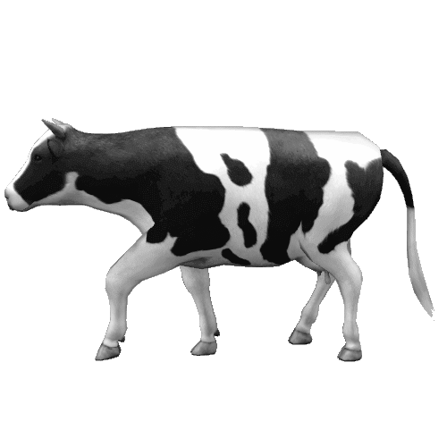
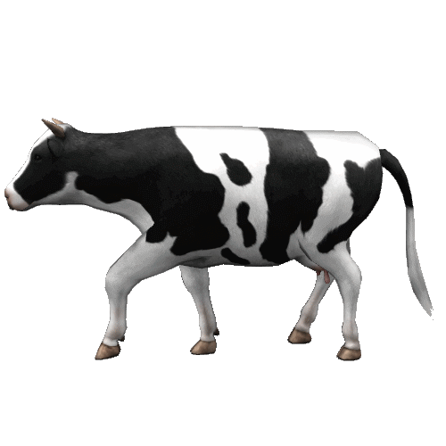
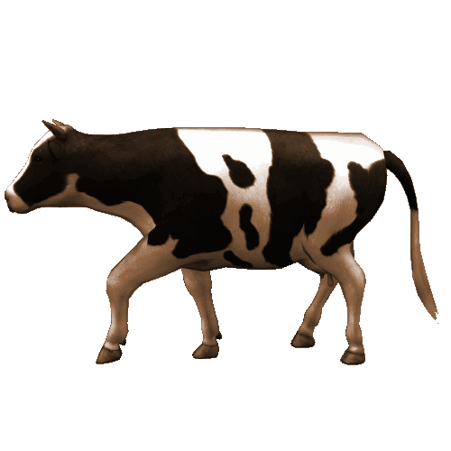
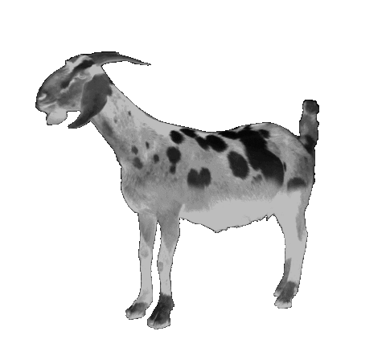
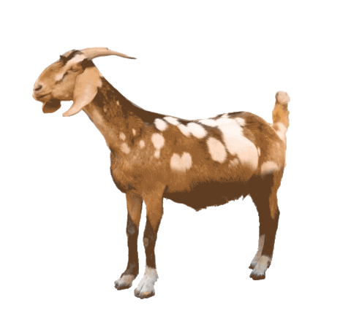
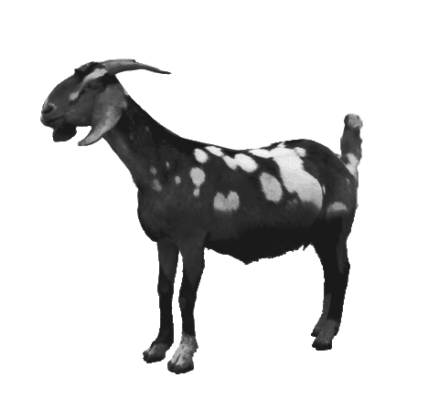
No, Alok. I want to pet that little black goat over there.
Vidya, did you want to pet this goat?
After petting the goats, Vidya and Alok go inside to give Amma the fruits they bought at the shop.

Slide 17
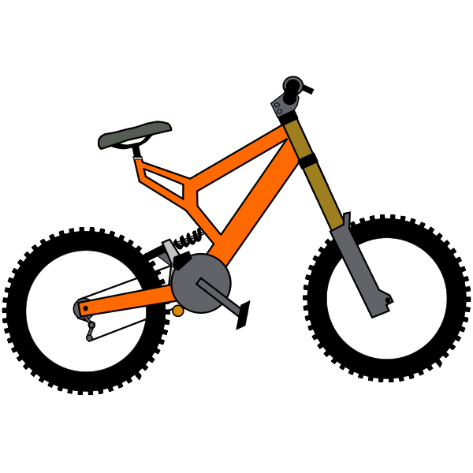
Ex. 1 : Tick the correct answer. Follow the example.
This/That is an orange cycle.
Do you want this/that apple?
Please pass me this/that book.
This/that is a big butterfly.
What is this/that?
I saw this/that flower in the shop.

Slide 18
Ex. 2 :Colour the balloons with ‘this’ -pink and balloons with that -‘green’. Count and write the number of balloons with ‘this’ and ‘that’ in the box below.
This
____
This
5
This is a green balloon.
That is an orange balloon.
That is a red balloon.
That is a yellow balloon.
This is a brown balloon.
This is a yellow balloon.
This is a red balloon.
That is a pink balloon.
That is a green balloon.
That is a blue balloon.
That
____
This is an orange balloon.
That
6

Slide 19
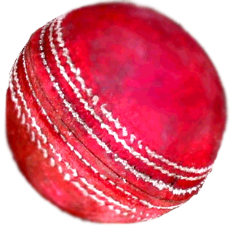
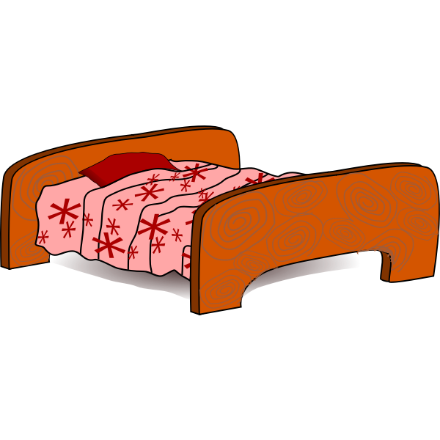
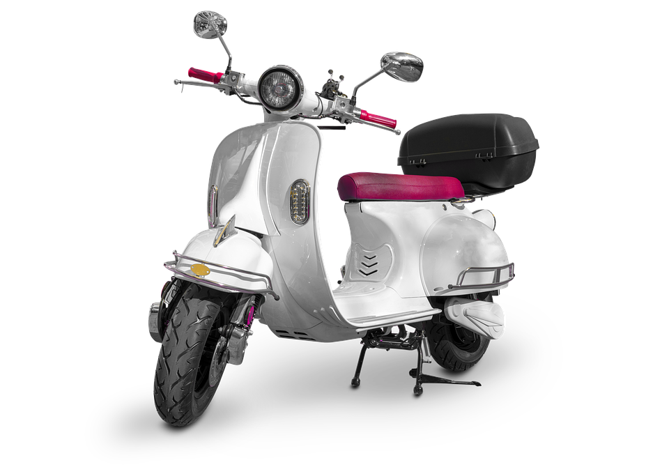
Ex. 3 : Match the picture to the correct word. Follow the example.
This
That

Slide 20
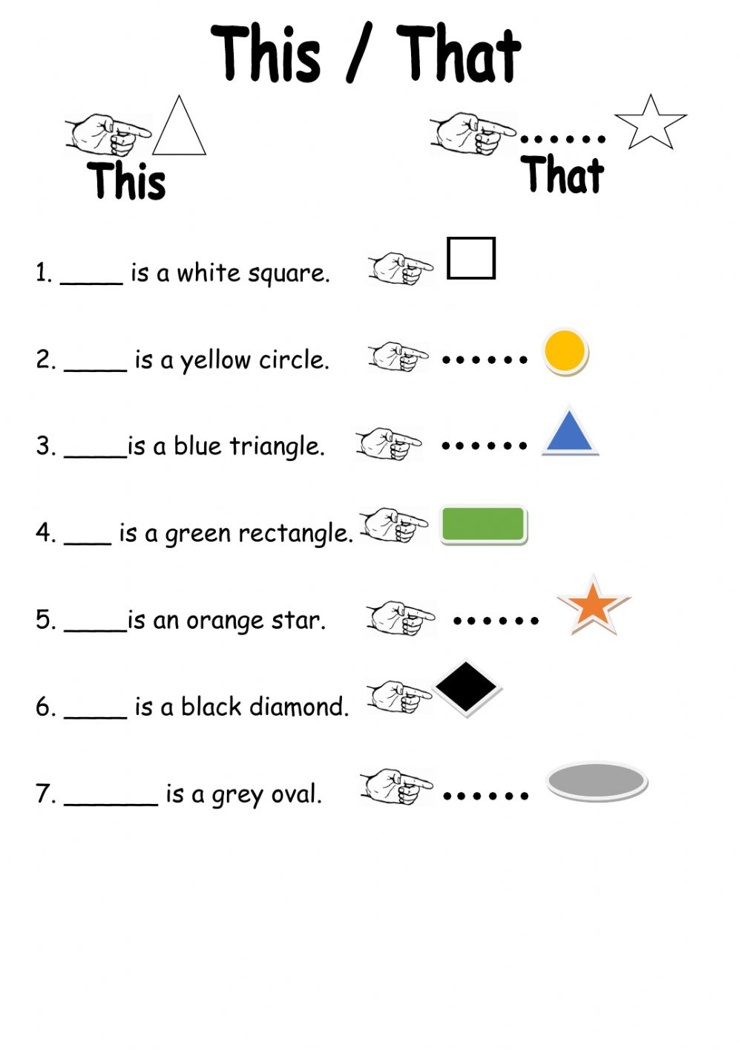
Ex. 4 : Write the correct word in the blanks.
This
That
That
This
That
This
That

Slide 21
Hope you had fun with
This
That
and

