Slide 1






Introduction to Career247 Learning Portal
We utilize the Career247 Learning Portal to streamline and centralize all learning activities throughout the course. Through this platform, you will be able to:
Access learning videos and resources
Track your attendance and upcoming events
View performance scores
Attempt quizzes and assessments
Upload assignments and project work

Slide 2
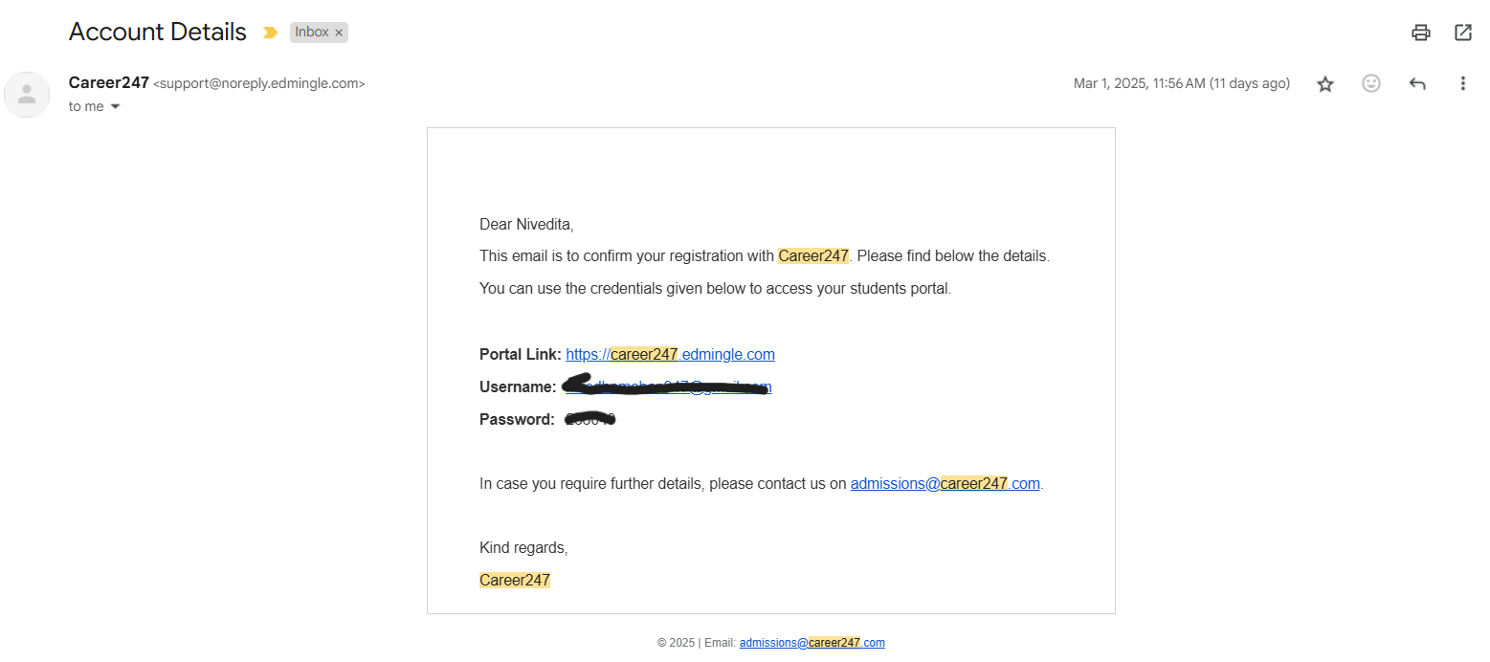
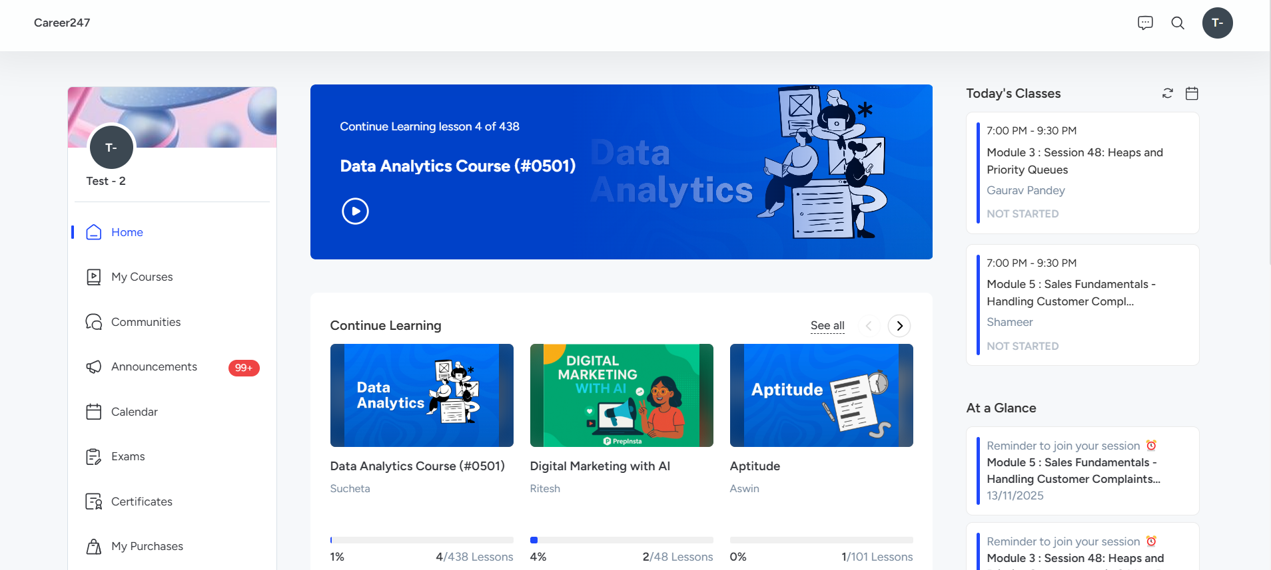
Students Dashboard
Step 1: Learners will receive an email at their registered email address containing the LMS portal link https://prepinsta-career247.edmingle.com/ along with their username and password. User will receive a link on whatsapp also within 24 hours.
Step 2: After logging into the LMS Portal, you will be directed to the Dashboard. Here, you can view the courses you’ve purchased, any scheduled classes for the day (if applicable), and important class updates or announcements related to your batches.

Slide 3
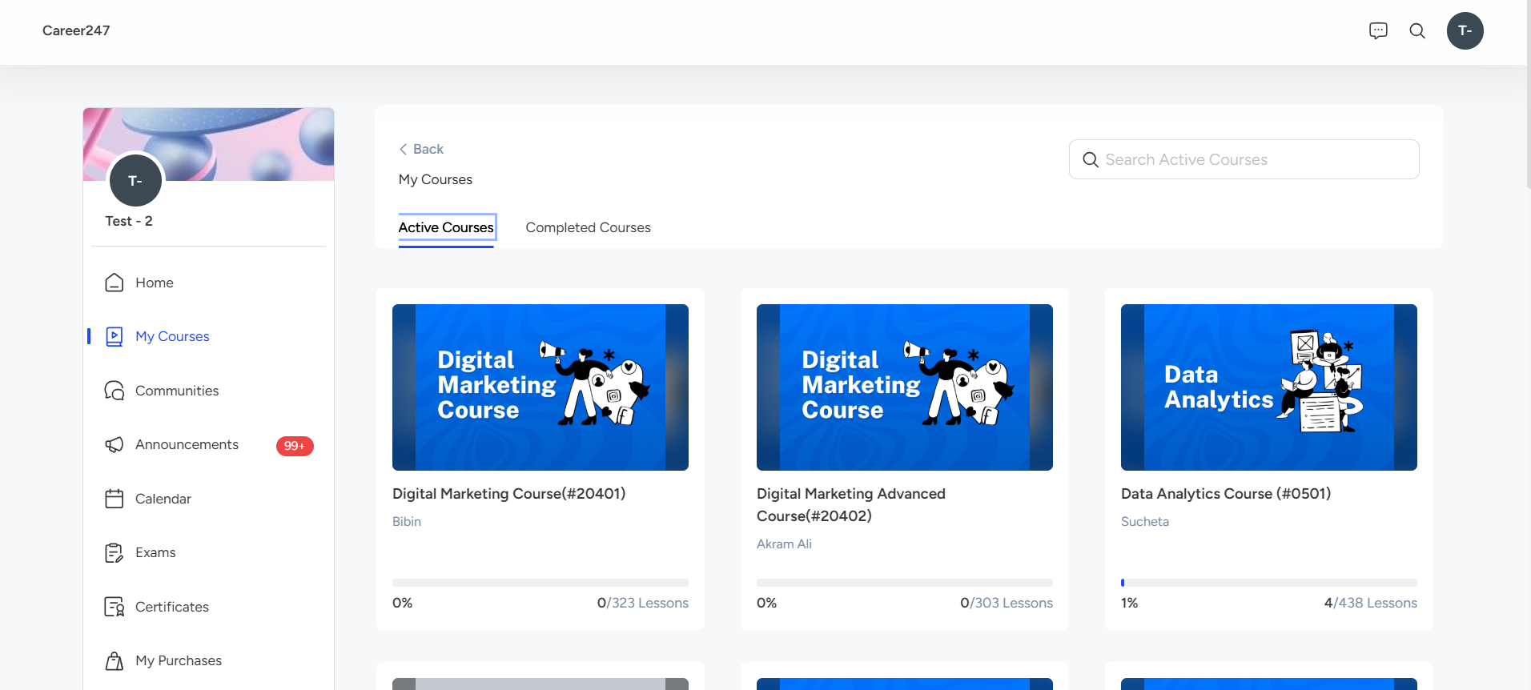
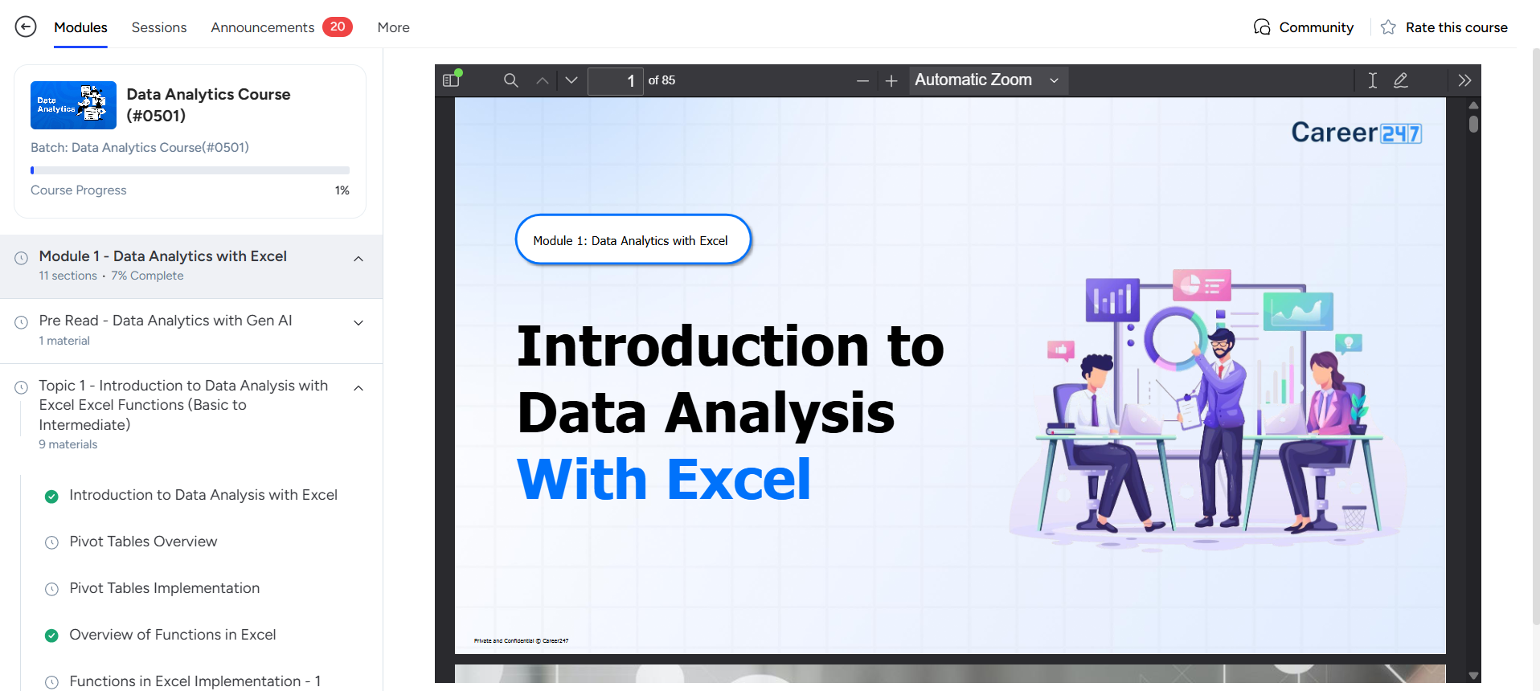
Students Dashboard
Step 3: Click on ‘My Courses’ to view all the courses you have purchased..
Step 4: Once you click on the course, you will see the contents, including the module details, on the left-hand side.

Slide 4
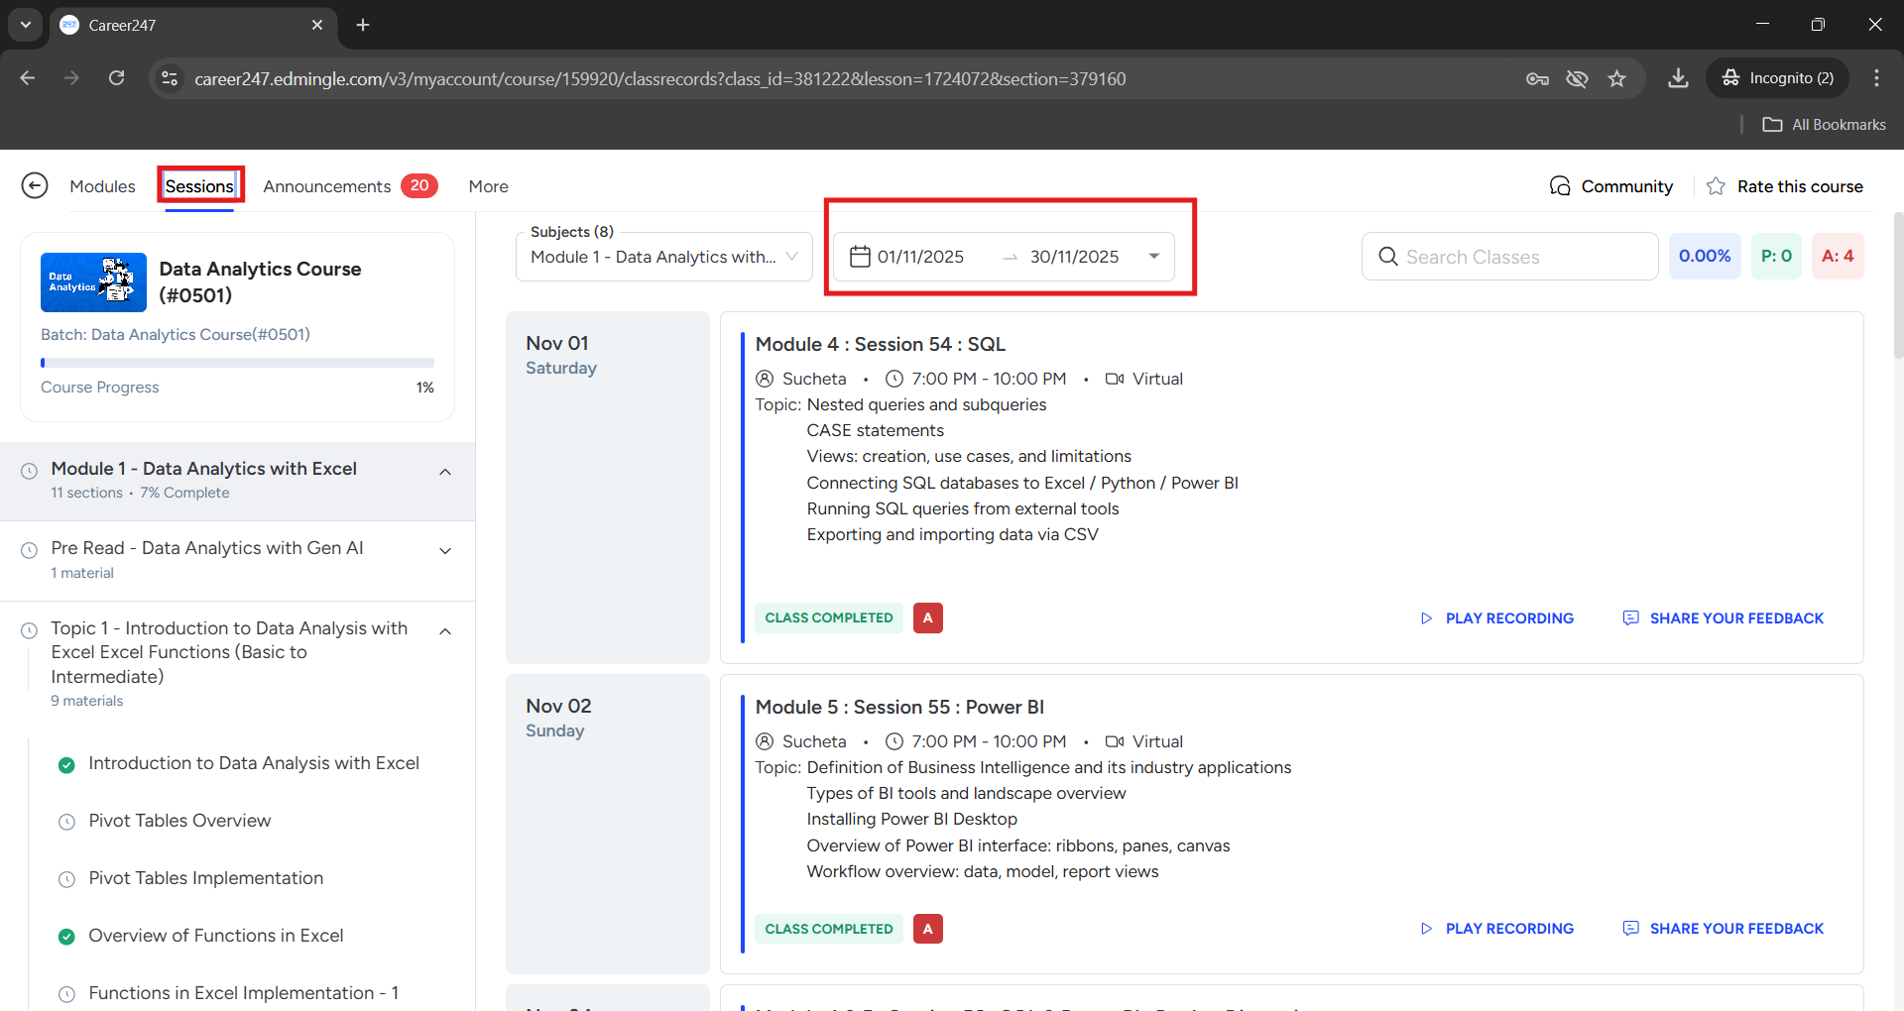
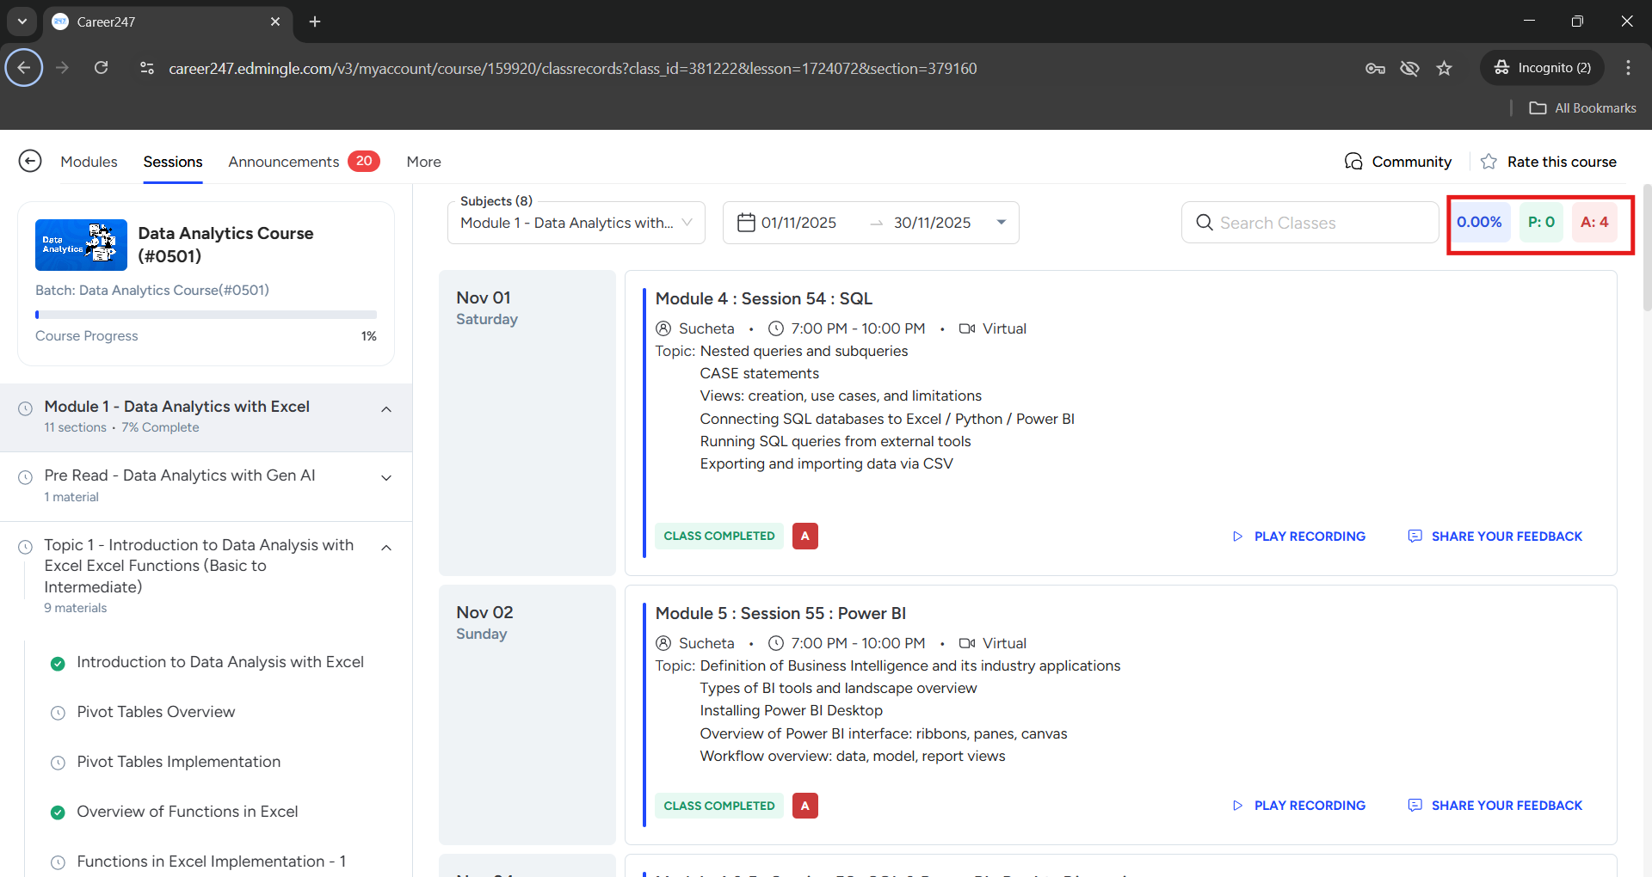
Students Dashboard
Step 5: Click on “Sessions" to view past class recordings, including the instructor details and topics covered in previous sessions. You can also filter the recordings by date, month or customized
Step 6: In the “Sessions” Tab, the Blue section shows the overall attendance percentage, the “Green section” shows the attendance count, and the “Red section” shows the absent count.

Slide 5
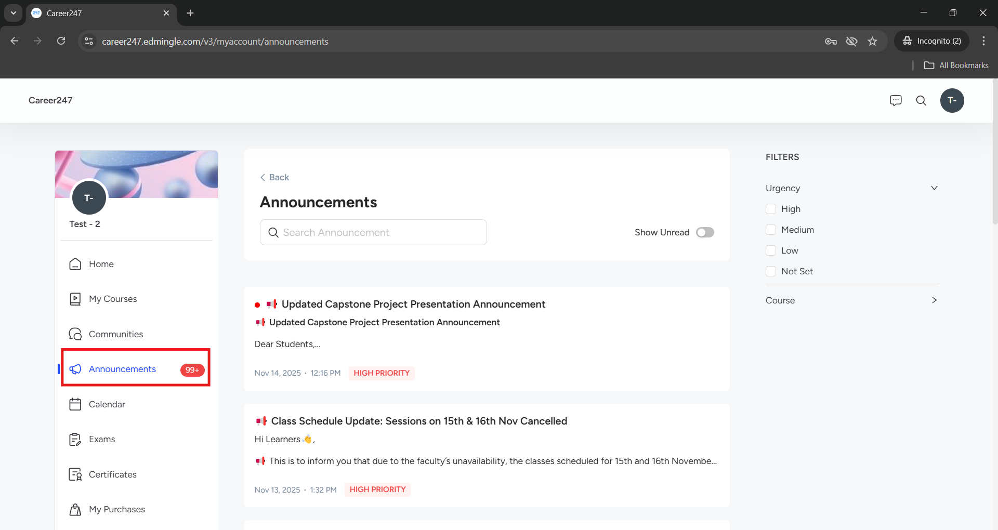
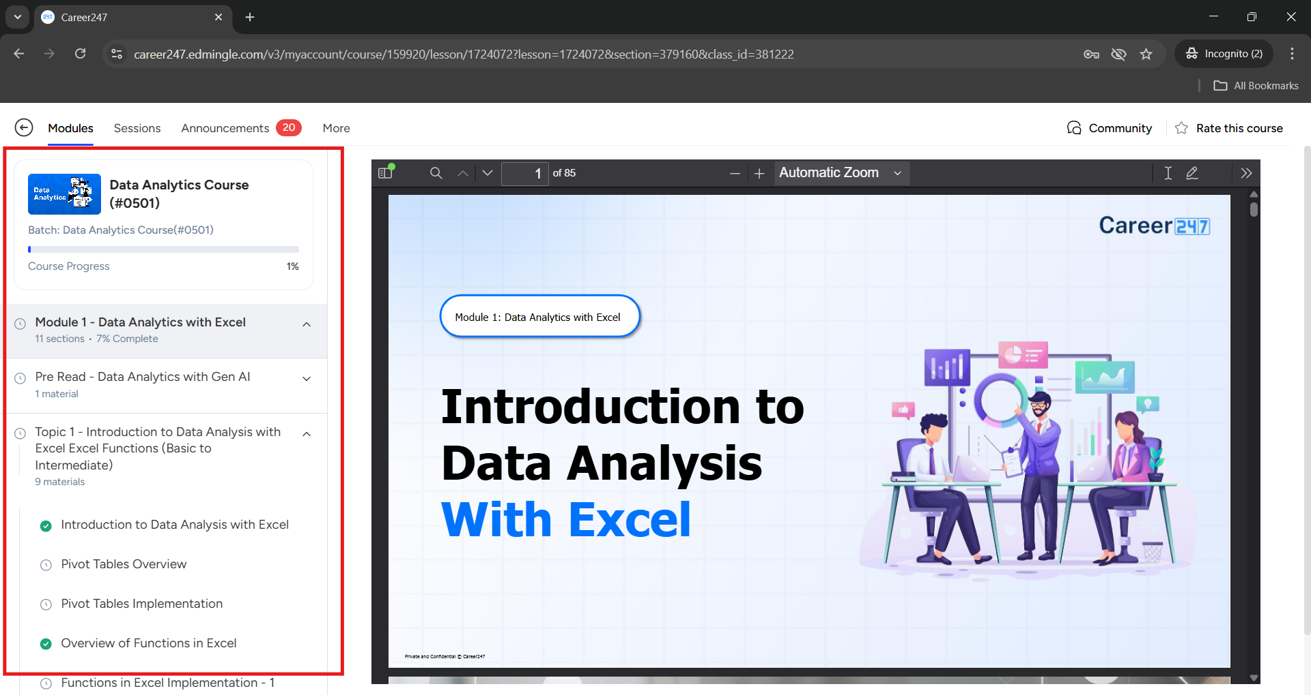
Students Dashboard
Step 7: In the "Announcement" section, learners will receive updates regarding notes, homework, exams, and other important information.
Step 8: In the “Module” section, by selecting the dropdown, you can view everything that has been uploaded Module-wise and Topic-wise.

Slide 6
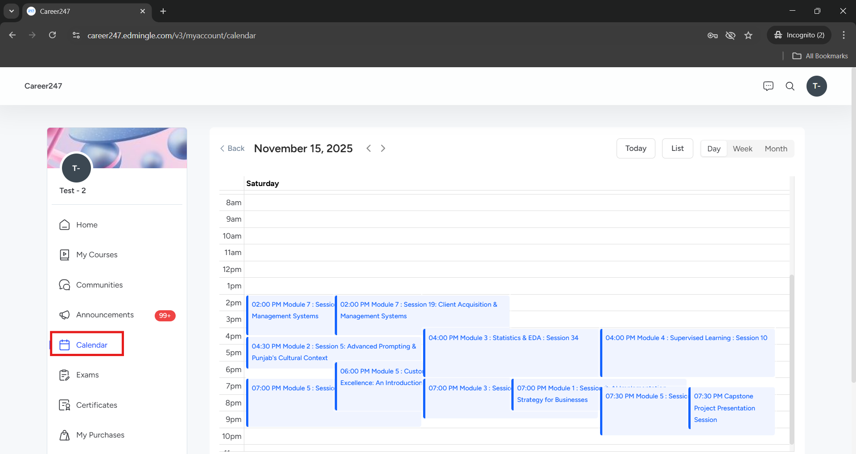
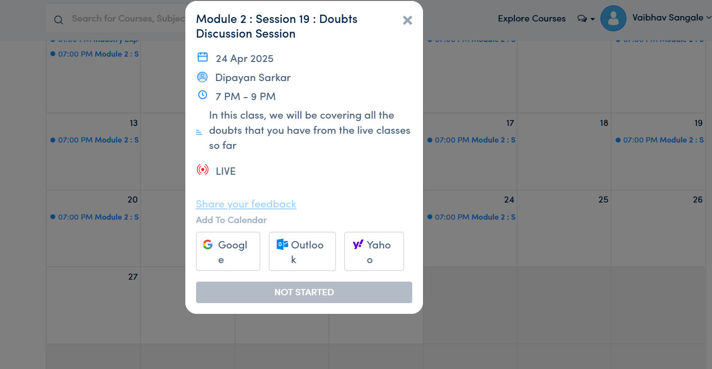
Students Dashboard
Step 9: Go to Dashboard and Click on "Calendar" to view all the sessions scheduled for the respective batch and click on the hyperlink.
Step 10: Once you click, the pop-up will appear. Click Join now and It will direct you to the Zoom session, provided the Zoom tool is installed on your laptop/desktop.
JOIN NOW

Slide 7
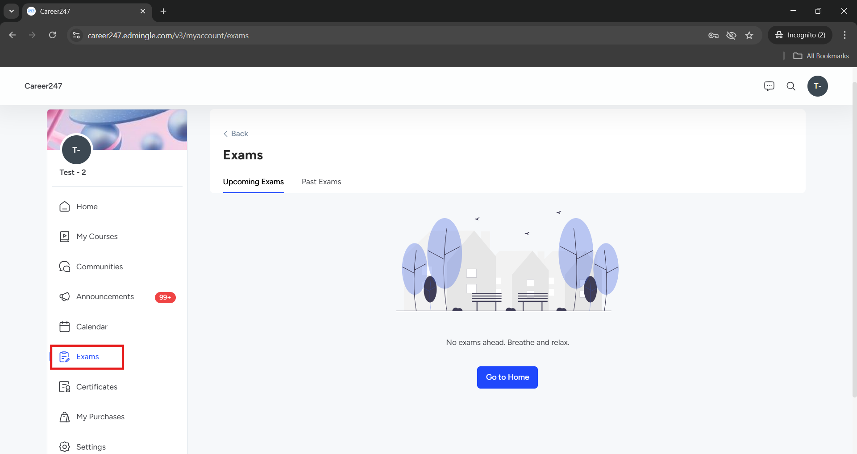
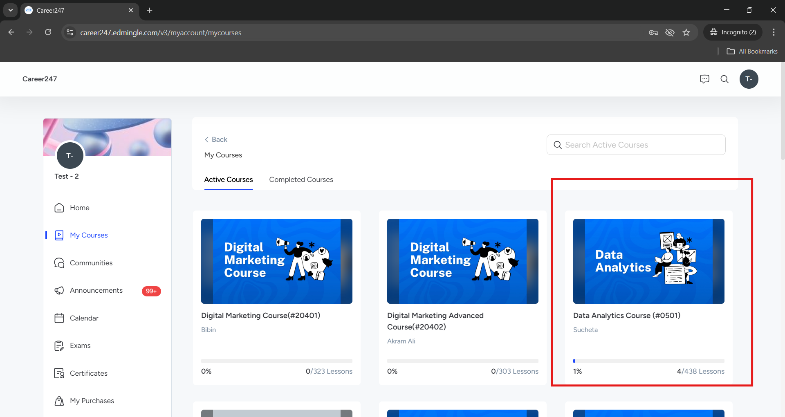
Students Dashboard
Step 11: Click on the ‘Exam’ section to view all the exams/tests scheduled for the batch.
Step 12: To navigate to your homework session, First go to dashboard and click your course

Slide 8
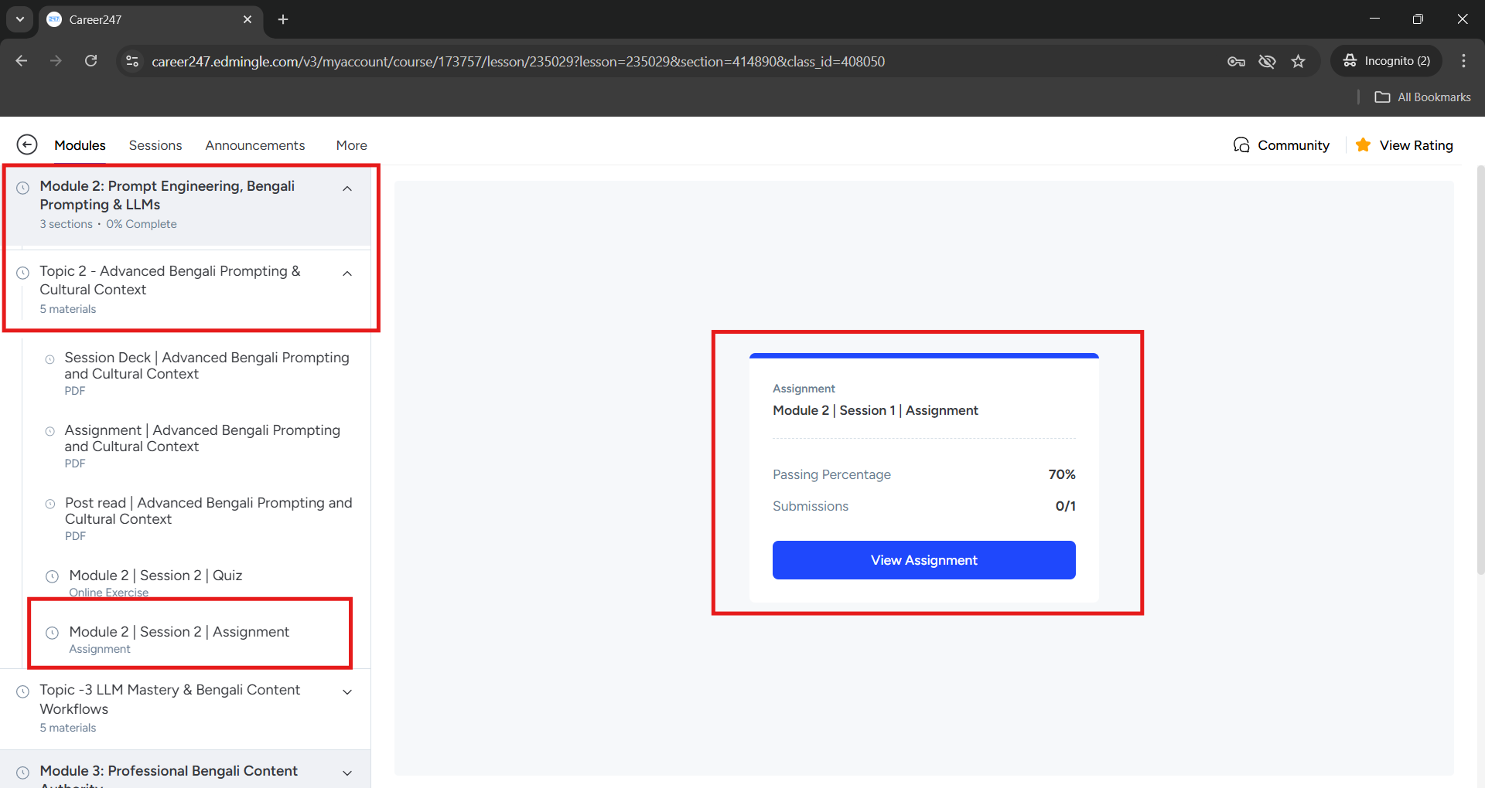
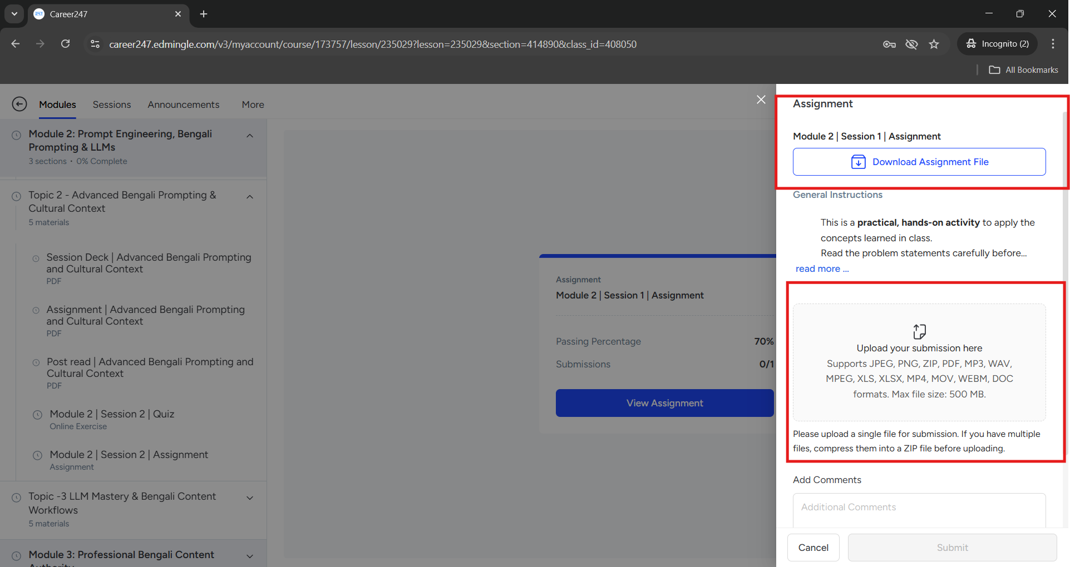
Students Dashboard
Step 13: Next, Under Module ➝ Topics ➝ Assignments, you can navigate step-by-step to view the assignments.
Step 14: Once you click on Assignments, You can download the rubrics file for the problem statement, and once you complete the Assignment, click on “Upload your submission here.” you can upload the Excel, PDF or JPGE Format, as shown in the figure below

Slide 9
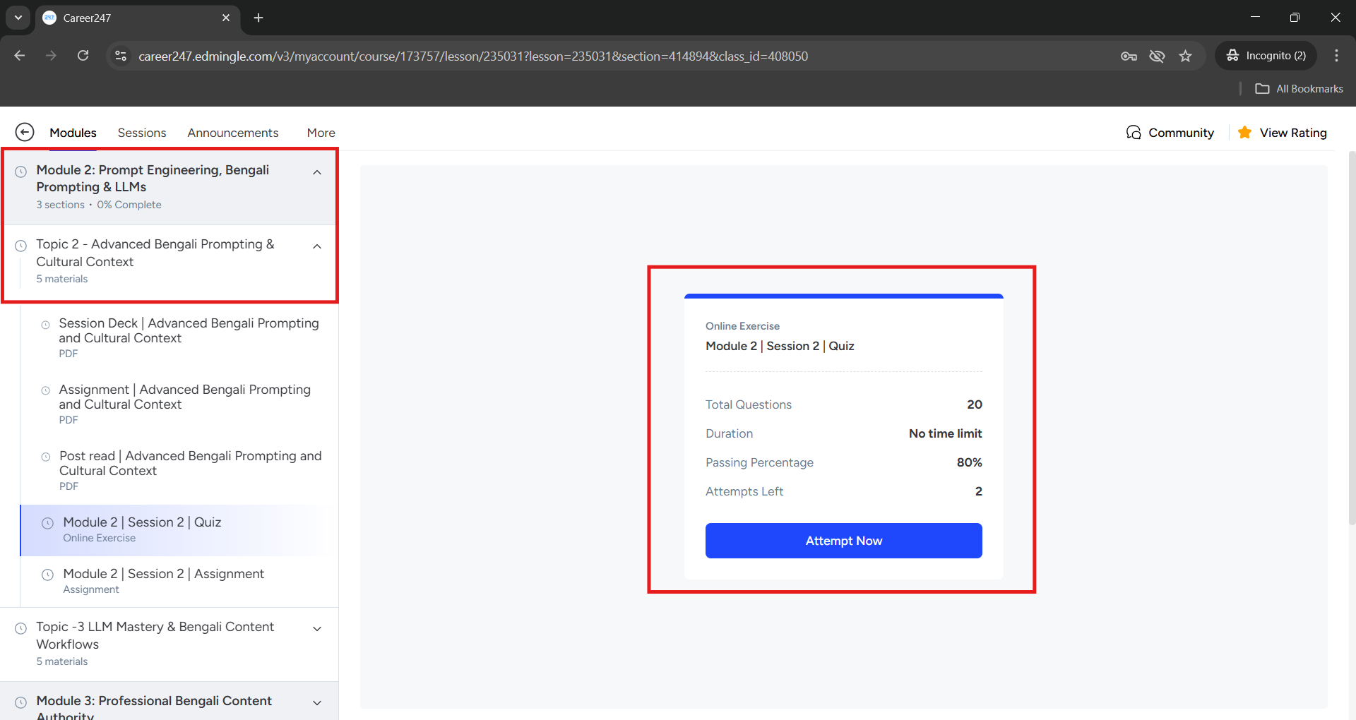






Students Dashboard
Step 15: Next, Under Module ➝ Topics ➝ Quiz, you can navigate step-by-step to view the Quiz.
Etiquette and Support
Make sure to regularly check the dashboard for announcements, new materials, and schedule changes.
Explore additional resources shared by trainers to enhance your learning experience.
For any technical issues or platform-related queries, please contact the Support Team at: support@career247.com

